Slide 3
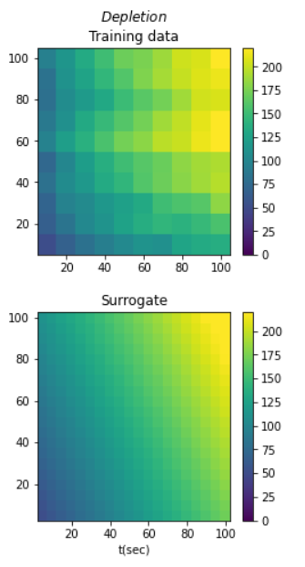
Model1
Depletion

Slide 4
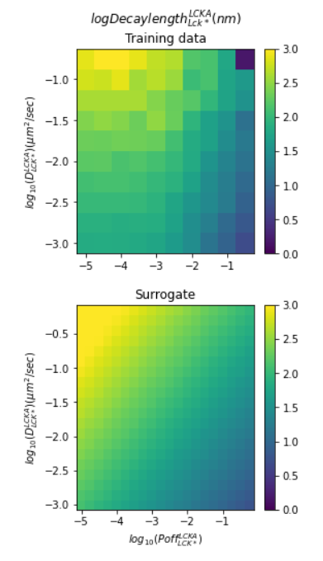
Model2
log₁₀decaylength

Slide 5
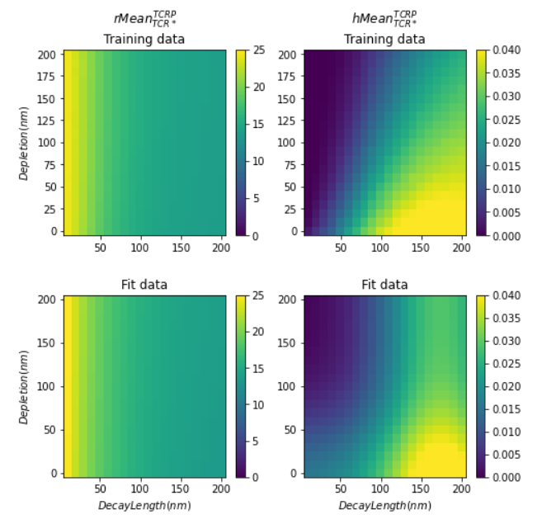
Model3
rMean
hMean

Slide 6
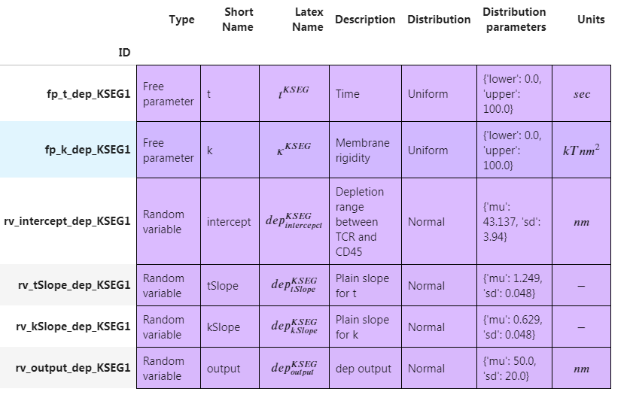
Model1
Depletion

Slide 7
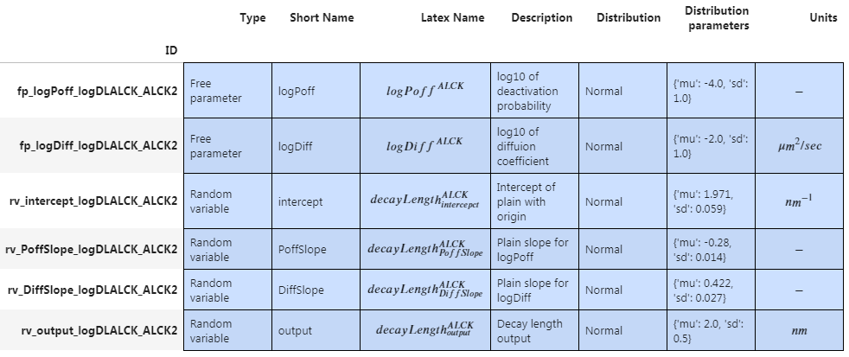
Model2
log₁₀decaylength

Slide 8
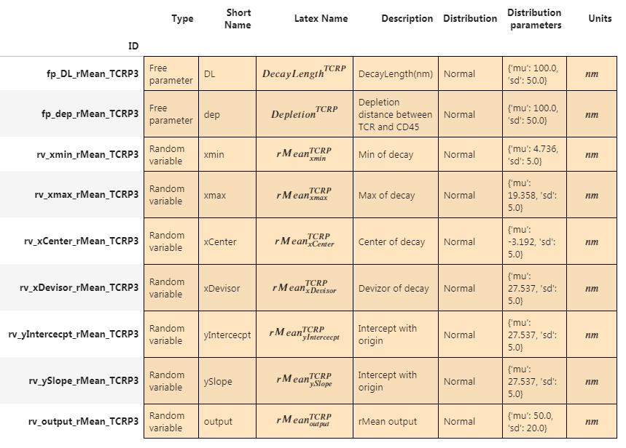
Model3
rMean

Slide 9
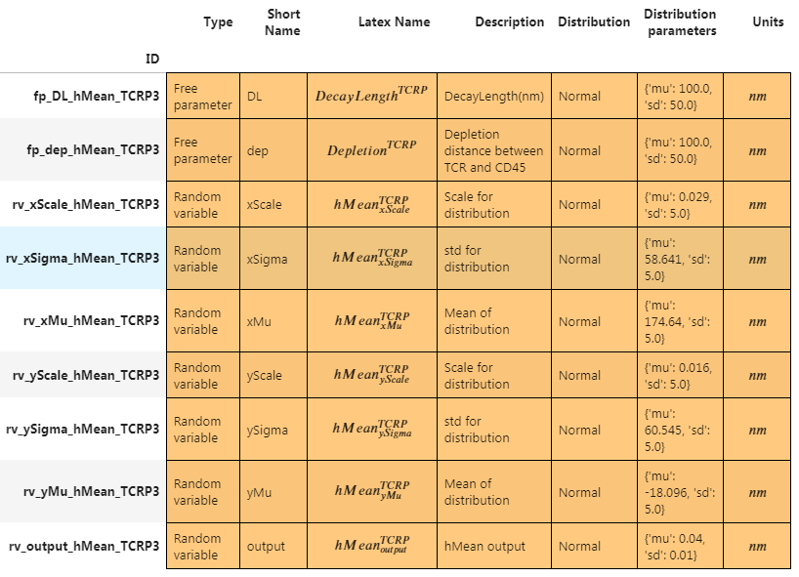
Model3
hMean

